Slide 1
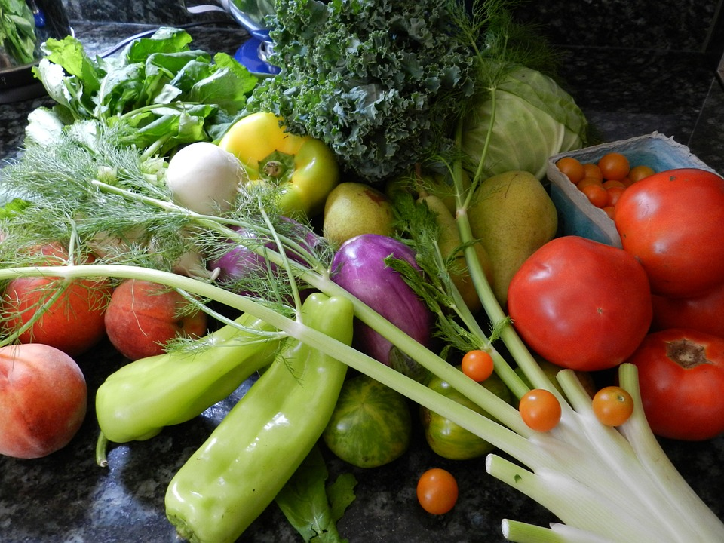
Vitamins
Presented by Arpit

Slide 2

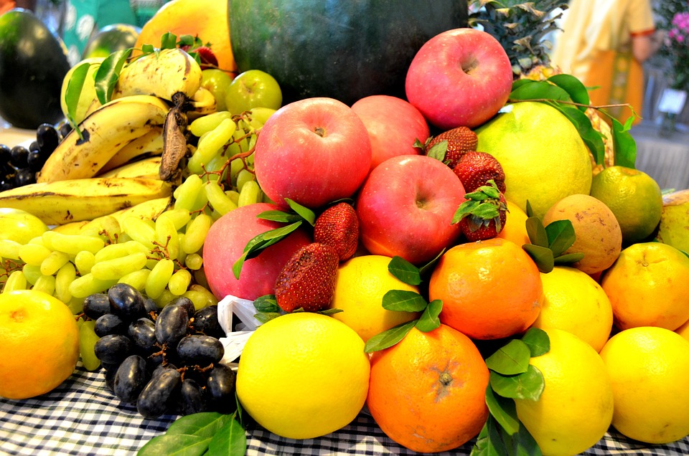
Vitamins
Nutrients that the body needs in small amounts to function and stay healthy. They are organic compounds that help with metabolic processes and are found in plant and animal food products.

Slide 3
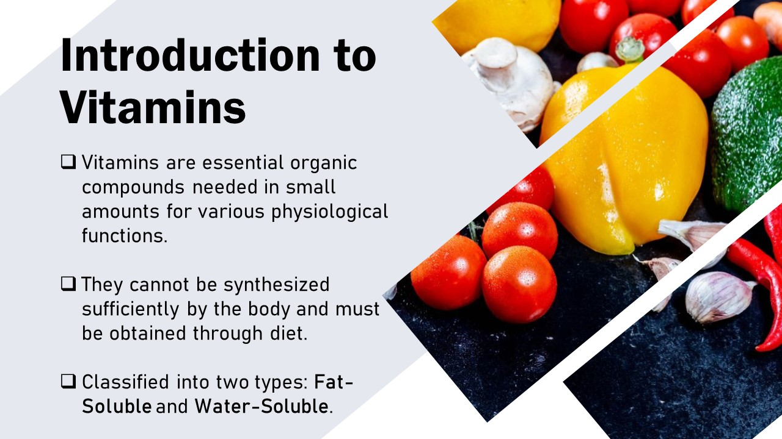

Slide 4

Types of Vitamins

Slide 5

Fat-Soluble Vitamins:
Not stored, need daily replenishment.
Examples: Vitamin B-complex (B1, B2, B3, etc.) and Vitamin C.
Water-Soluble Vitamins:
Stored in the body’s fat tissues.
Examples: Vitamin A, D, E, K.

Slide 6
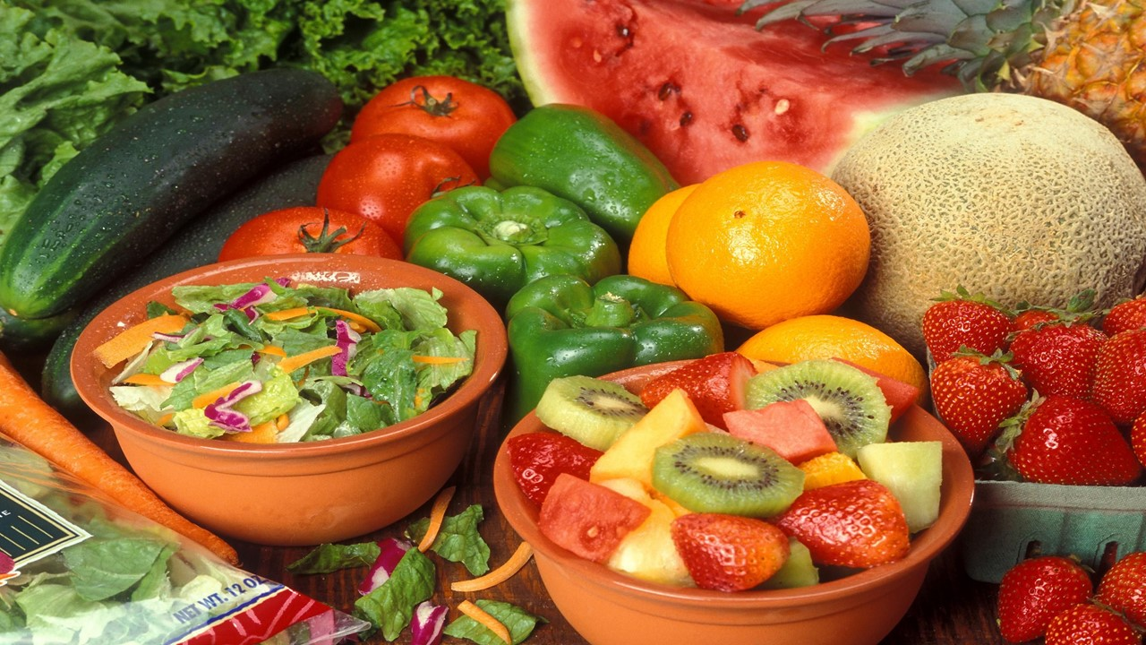
Vitamin A: Vision, skin health.
Sources: Carrots, sweet potatoes, spinach.
B-complex Vitamins: Energy, brain health.
Sources: Whole grains, meat, eggs, dairy.
Vitamin C: Immunity, skin repair.
Sources: Citrus fruits, bell peppers, strawberries.
Vitamin D: Bone health, calcium absorption.
Sources: Sunlight, fatty fish,
fortified milk.
Vitamin E: Antioxidant, skin health.
Sources: Nuts, seeds, vegetable oils.

